Slide 1

Lending Club – EDA Case Study Risk Analysis
Submitted By
Muniaraja Murugan
Group Facilitator
Email ID: muniarajam2011@gmail.com
Phone No: +1 2017230335
Vivek Trivedi
Team Member
Email ID:vivek3vedi@gmail.com
Phone no: +1 2484210721
3/6/2022

Slide 2
Contents
Case Study Objectives
Scope and Solution Approach
Introduction - Data Understanding
Data Cleaning & Manipulation
Data Preparation & Transformation
Descriptive Statistics 🡪 Finding Data Relationships & Correlation
Predictive Models 🡪 Univariate, Bivariate and Multivariate Analysis
Data Analysis
Recommendations
Prescriptive Models 🡪 Visual Aids(Data Visualizations & Inferences)
Conclusions

Slide 3




Scope, Objective & Solution
Scope
Objective
As a Data Scientist, help Lending Club(A marketplace for personal loans) to understand the driving factors behind loan default.
Lending Club can utilize this knowledge for its portfolio, risk assessment, acquire more customers and to maximize its revenue.
Leverage various Data Science techniques, models and algorithms of Data Analysis and discover patterns, spot anomalies and derive inferences/insights from the data shared
Translate the inferences into prescriptive recommendations that can be utilized by Lending Club
Solution Approach
Data Manipulation
&
Transformation
Data Cleaning
Data Analysis
Recommendations
Null value verifications (Delete and Drop Columns)
Delete duplicate values
Perform type check
Data formatting and structuring to promote interoperability
Enable higher degree of data quality
Univariate Analysis
Continuous and Categorical
Bivariate/Multivariate Analysis
Correlation
Visualization & Reporting
Graphs and Insights
Prescriptive Decision Making

Slide 4
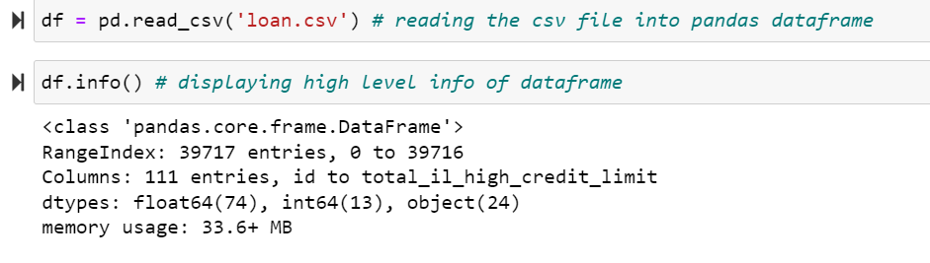
Cleaning of Lending Club Data
Why Data Cleaning required?
First step in Data Science
Identify and Solve Data Quality Problems
Makes Data Credible
How did we clean the Lending Club Data?
Snap Screen-Shot
Identify and Remove Missing Values and Duplicate rows in Loan Dataframe
Removing columns that are not useful for analysis
Formatting columns data, data correction into the right format
If the column has few null values, impute the missing values(Ex. Filling missing values in emp_length with mean values)
Findings from Data Cleaning
The raw data file had 111 columns and 39717 Rows
Dropped customer behaviour and post loan approval variables
Removing outliers (Ex. Annual income and installment variables)

Slide 5
Analysis of Lending Club Data
Driver Variables
Data Binning, Correlation etc..
Methods or Type of Analysis
Risk is high when borrower has home on rent of mortgage.
Loan taken for debt consolidation can be considered as high risk
Loan purpose
Home ownership
Business
Driven
25% people failed to pay the loan when loan term is 60 months
Loans with higher amount and high interest rate are considered as risk
Interest rate and term
Loan amount
Type
Driven
Debt to income ratio
Annual income
Debt to ratio should be low for approving loans
People with low income asking bigger loans can be considered as risk
Data
Driven

Slide 6
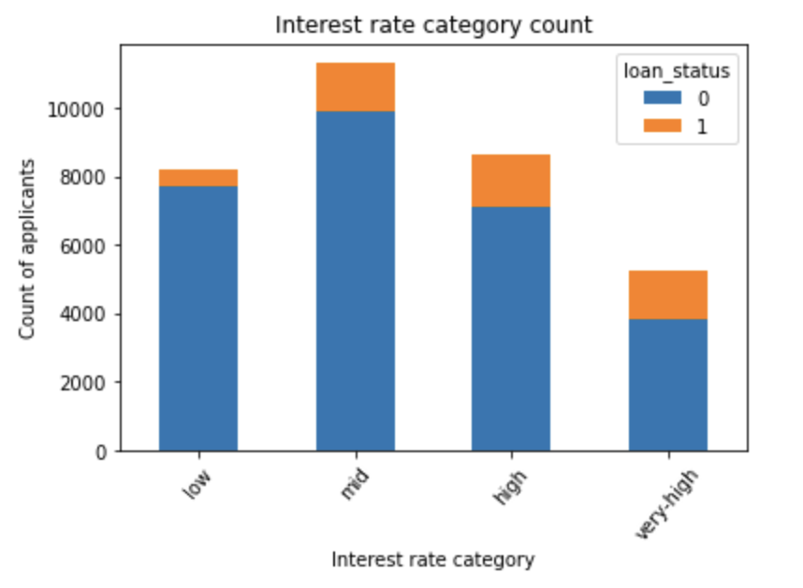
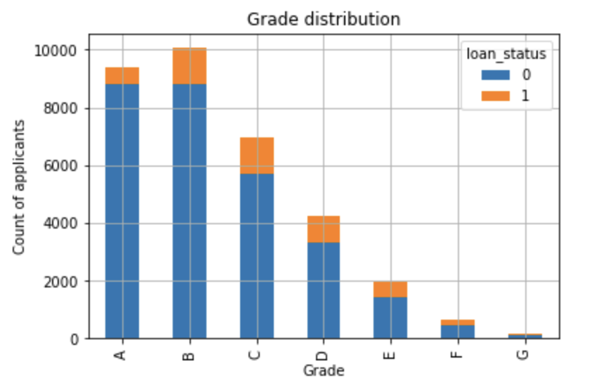
Inference of Lending Club Data Analysis
27% of applicants who have borrowed loan at very high interest rate (>15% int rate) haven’t been charged off the loan.
Loans given for applicants under D and E grade are high risky loans as 24% of applicants under these grades have failed to pay the loan.

Slide 7
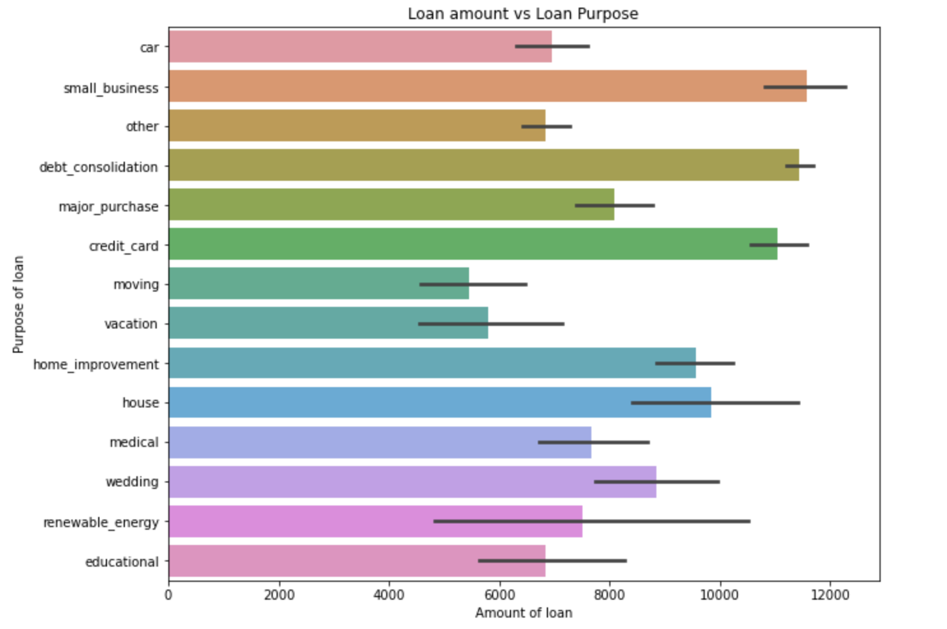
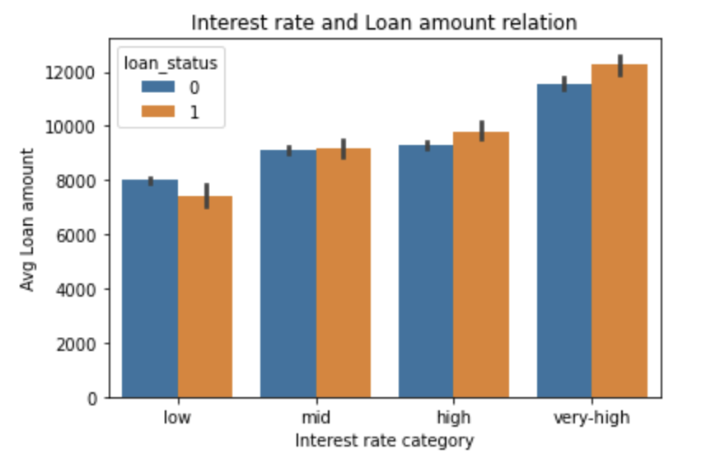
Inference of Lending Club Data Analysis Cont..
Applicants with loan purpose as “credit card payment”, “debt consolidation” and “small business” can be considered as high risk loans.
Increase in the interest rate and loan amount increases the probability of loan being defaulted

Slide 8
Final Recommendations to Business(Investors)
Applicants with loan purpose as “credit card payment” or “debt consolidation” can be considered as high risk loans.
Debt to income ratio of applicant should not be high for safe loans.
Loan for small business has the highest probability of Likely to be as a Defaulter of 26%. So, bank should take extra caution while approving the loan for purpose of 'small business'.
Loans given for applicants under D and E grade are high risky loans as 24% of applicants under these grades have failed to pay the loan
Increase in Loan Amount is increasing the probability that person will default (increasing with highest at 25000 & above bracket)
Increase in interest rate is increasing the probability that person will default (increasing with highest at 15% & above bracket)
Low-income range – People in the lower income bucket are more defaulters
Summary of the Recommendations
1
3
5
2
4
6

